Slide 1
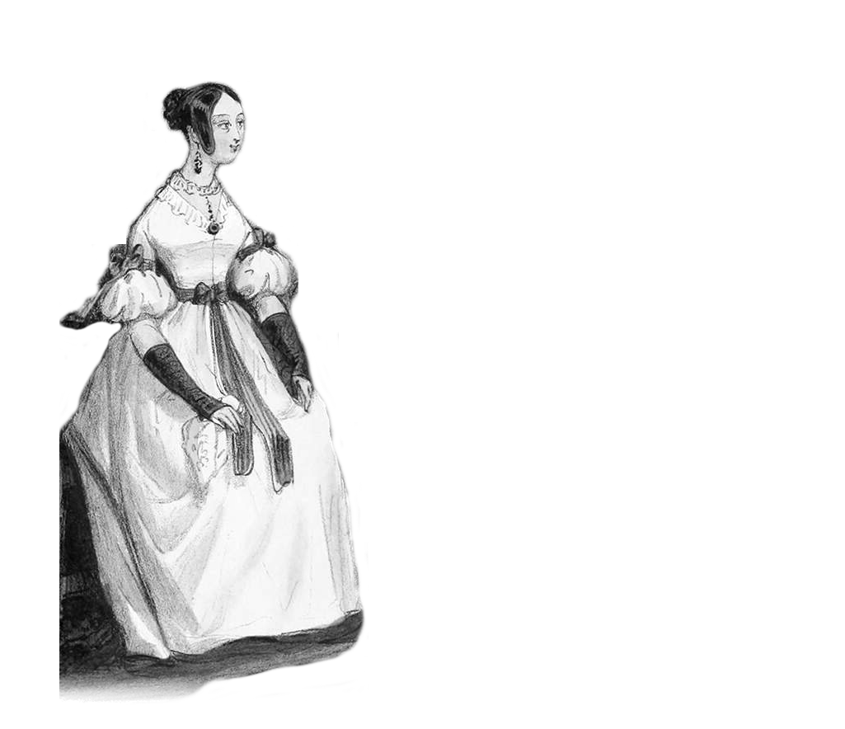
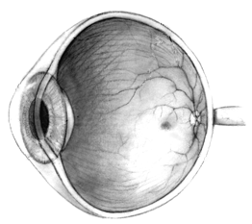
Your eye
My image
My data?
Your data?
Data about me?
Me

Slide 2


